Slide 1
Exploring the Psychological Impact of Human-Robot Interaction: A Comprehensive Study
Sai Nikhil Nandala

Slide 2
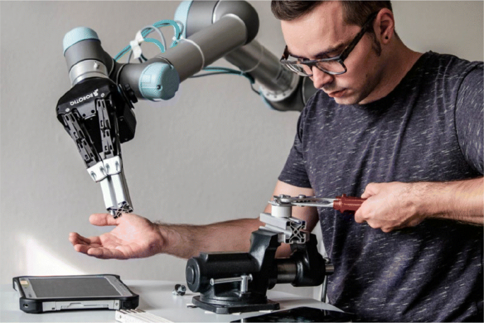
HUMAN ROBOT INTERACTION (HRI)
The study of interactions between humans and robots.
They are ubiquitous, serving roles in healthcare, education, homes, and public spaces.
The prevalence of robots is reshaping human experiences.
In an era where robotics is becoming increasingly integrated into our daily lives, understanding the psychological impact of this interaction is paramount.

Slide 3
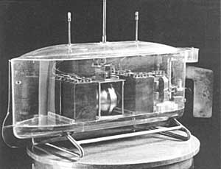
EVOLUTION OF HRI
Zhang heng in 78 AD created a robotic cart measuring distance, and during the tang dynasty, yang wulian crafted a humanoid monk
Nikola tesla's radio-controlled boat in 1898 was an early example, envisioning a future race of robots doing human labor.
The naval research laboratory's "electric dog" robot in 1923, attempts to remotely pilot bombers during wwii, and the development of remotely piloted vehicles.
Early attempts at fully autonomous robots, with shakey as a notable example navigating a block world in the 1960s.
The emergence of hybrid architectures in the mid-1980s allowed sophisticated reactive behaviors and high-level cognitive reasoning.
Robust robot platforms for extreme environments, pioneered by nasa and international space agencies.
Human factors experts explored teleoperation and supervisory control paradigms.
Available from: https://humanrobotinteraction.org

Slide 4
Emergence of HRI (Mid 1990s - Early 2000s)
IEEE International Symposium on Robot & Human Interactive Communication (RoMan)
International Conference on Humanoid Robots (2000)
NSF and DARPA Workshops (2001, 2006)
IEEE-RAS and IFRR Summer School (2004)
ACM International Conference on Human-Robot Interaction (HRI) (2006)
Influential Competitions

Slide 5
Types of Human-Robot Interaction
Social Robots
Service Robots
Collaborative Robots (Cobots)
Telepresence Robots
Exoskeletons
Assistive Robots
Educational Robots
Entertainment Robots
Therapeutic Robots
Industrial Robots

Slide 6
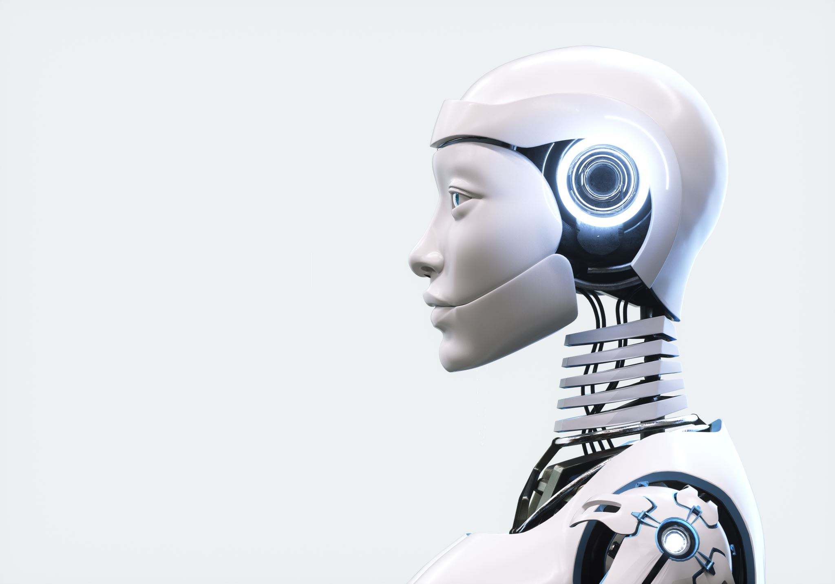
Risks Associated with Human-Robot Interaction (HRI)
Physical Safety Concerns
Privacy and Data Security
Ethical Dilemmas
Emotional Impact Job Displacement
Dependency and Trust Issues
Bias and Fairness
Legal and Regulatory Challenges
Human Deception
Unintended Consequences

Slide 7
Significance of Understanding Psychological Impact
User Acceptance and Adoption
Optimizing Collaboration
Mitigating Anxiety and Resistance
Ethical and Responsible AI
Positive User Experience

Slide 8
Positive Psychological Impact
Emotional Support and Companionship
Therapeutic and Rehabilitation Benefits
Reducing Social Isolation
Enhancing Cognitive Function
Supporting Mental Health Therapies
PARO – Therapeutic seal

Slide 9
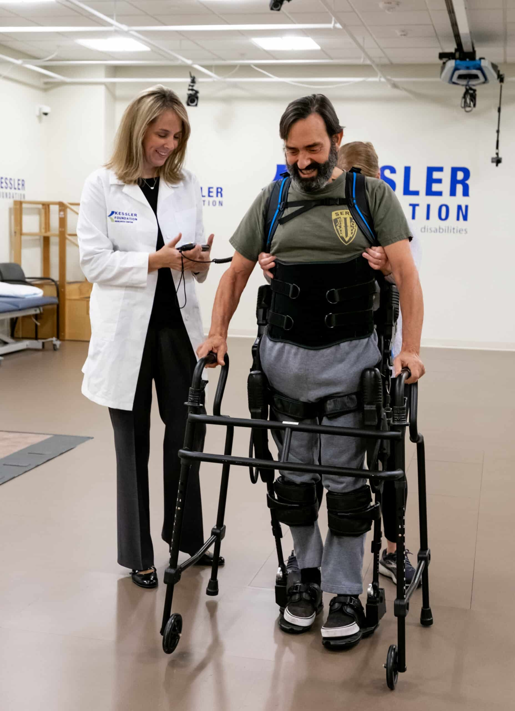
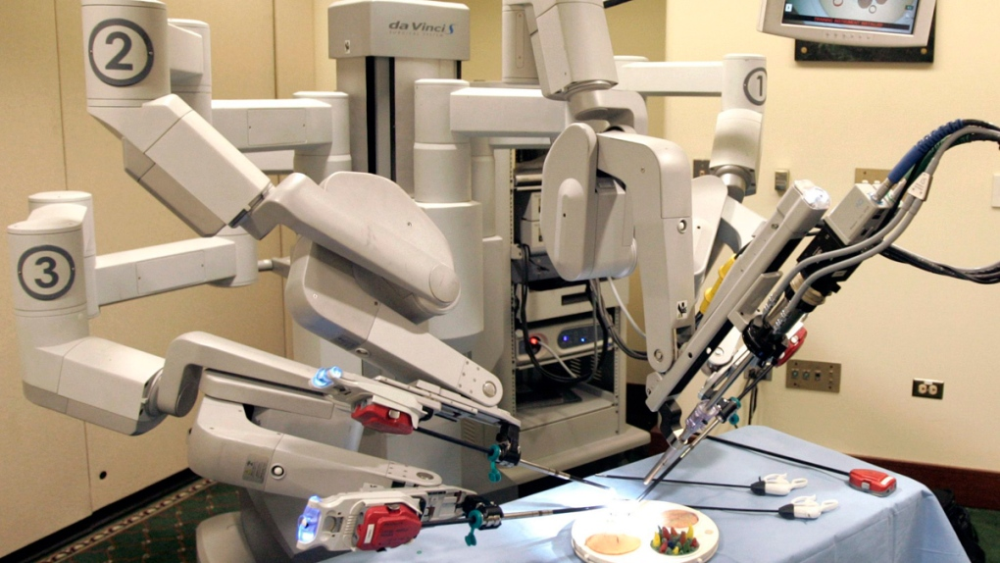
Promoting Physical Activity and Exercise
Facilitating Learning and Skill Development
Reducing Stress in High-Pressure Environments
Boosting Mood and Happiness
Promoting Social Skills in Children
Available from:
https://www.ctvnews.ca/sci-tech/da-vinci-surgical-robot-goes-on-museum-display-1.2169974?cache=yes%3FclipId%3D86116

Slide 10
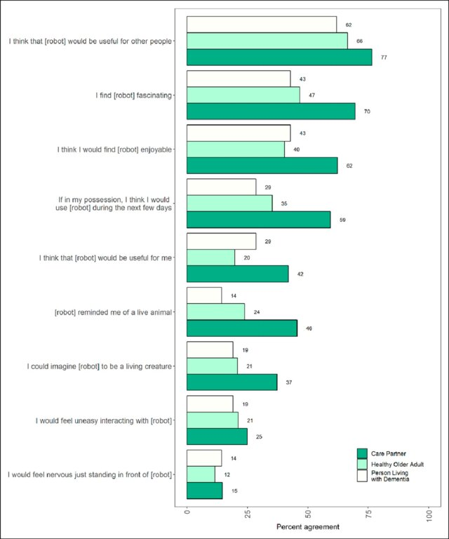
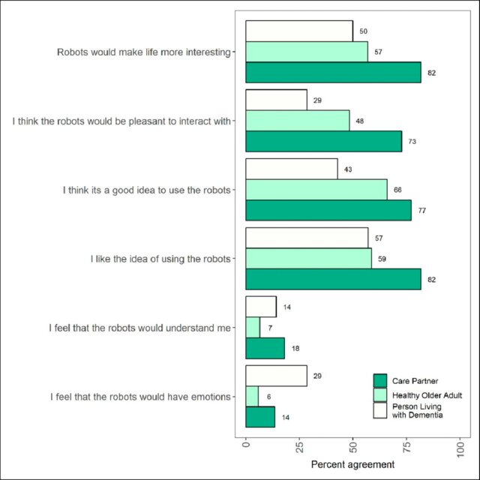
User perspectives on emotionally aligned social robots for older adults and persons living with dementia
Reference: Journal of rehabilitation and assistive technologies engineering. 2022 Jun 22;9:20556683221108364

Slide 11
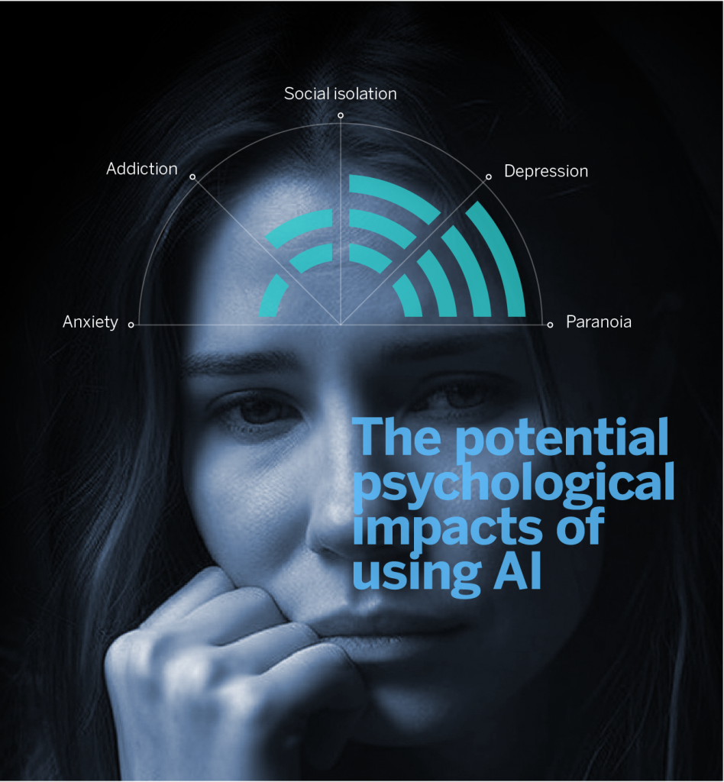
Negative Psychological Impact
Increased social isolation
Technostress and anxiety
Ethical dilemmas and moral distress
Loss of employment and job insecurity
Dehumanization and objectification
Privacy concerns and surveillance anxiety
Dependency and reduced self-efficacy
Bias and discrimination
Attachment and grief
Fear of technological malfunctions
Reference: https://www.bbvaopenmind.com/en/technology/digital-world/psychological-impacts-of-using-ai/

Slide 12
Factors Influencing Psychological Impact
Design and appearance
Context of interaction
User expectations
Intention and purpose
Communication skills
Adaptability and learning
Transparency in functionality
Cultural sensitivity
Personalization and customization

Slide 13
Negative Impact Scenarios
1. Technical Failures and Frustration: Bottle Handover Task
Scenario:
Participants engage in a bottle handover task with a robot, expecting smooth interaction.
Events:
Robot commits technical errors such as dropping the bottle or moving to the wrong location during handover.
Impact:
Participants experience immediate frustration due to technical failures, evidenced by facial expressions and reactions.
Frustration leads to decreased task productivity, longer decision-making times, and lower satisfaction with the interaction.
Reference: https://www.frontiersin.org/journals/psychology/articles/10.3389/fpsyg.2021.640186

Slide 14
2. Job Displacement Anxiety with Industrial Automation
Scenario:
Employees in a manufacturing plant witness the introduction of robotic automation, potentially threatening job security.
Events:
Workers experience anxiety and frustration as automation leads to job displacement and uncertainty about future employment.
Impact:
Frustration arises from perceived lack of control over the situation, leading to decreased motivation and productivity among workers.
Job displacement anxiety contributes to negative emotions and affects overall workplace morale.

Slide 15
3. Trust Issues with Autonomous Vehicles
Scenario:
Individuals encounter autonomous vehicles on roads, experiencing uncertainty and trust issues.
Events:
Users exhibit frustration and anxiety when autonomous vehicles display unpredictable behaviors or errors during operation.
Impact:
Frustration arises from perceived lack of control and trust in the technology, leading to reluctance to adopt autonomous vehicles.
Trust issues with autonomous vehicles contribute to negative perceptions and hinder widespread acceptance.

Slide 16
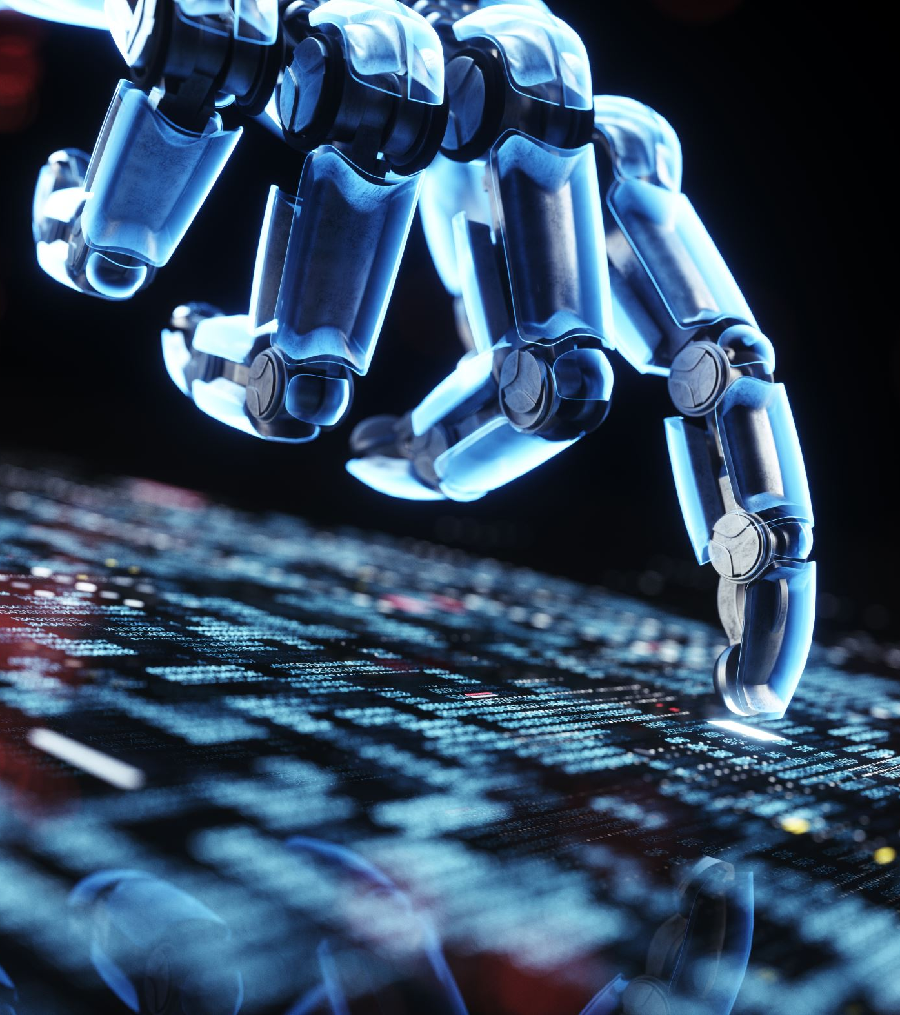
Future Trends
Enhanced emotional intelligence in robots
Personalized interaction and adaptability
Integration of virtual and augmented reality
Collaborative cognitive robotics
Ethical and transparent AI design
Continuous learning and improvement

Slide 17
CONCLUSION
As human-robot contact evolves, these future tendencies have the potential to influence the psychological impact of these interactions. By combining innovative technology, moral reflection, and user-centered design, positive psychological effects can be achieved, promoting a positive and peaceful coexistence of humans and robots.

Slide 18
References
[1] Vasic M, Billard A. Safety issues in human-robot interactions. 2013 IEEE International Conference on Robotics and Automation [Internet]. 2013 [cited 2024 Feb 27]. p. 197–204. Available from: https://ieeexplore.ieee.org/document/6630576
[2] Noh D, Shim M-S. Effectiveness of Robot Interventions for Cognitive and Psychological Outcomes among Older Adults with Cognitive Impairment: A Meta-Analysis. Healthcare (Basel). 2023 Aug 19;11(16):2341. PMCID: PMC10454070
[3] Sanders NE, Xie Z, Chen KB. A comparison of the psychological effects of robot motion in physical and virtual environments. Applied Ergonomics. 2023 Oct 1;112:104039.
[4] David. Robotic replacement and psychological responses to technology [Internet]. Association of MBAs. 2020 [cited 2024 Feb 27]. Available from: https://www.associationofmbas.com/robotic-replacement-and-psychological-responses-totechnology/
[5] Dosso J, Bandari E, Malhotra A, Guerra G, Hoey J, Michaud F, Prescott T, Robillard J. User perspectives on emotionally aligned social robots for older adults and persons living with dementia. Journal of rehabilitation and assistive technologies engineering. 2022 Jun 22;9:20556683221108364.
[6] Banafa A. Psychological Impacts of Using AI [Internet]. OpenMind. 2023 [cited 2024 Feb 29]. Available from: https://www.bbvaopenmind.com/en/technology/digital-world/psychological-impacts-of-using-ai/
[7] Weidemann A, Rußwinkel N. The Role of Frustration in Human–Robot Interaction – What Is Needed for a Successful Collaboration? Frontiers in Psychology [Internet]. 2021 [cited 2024 Feb 29];12. Available from: https://www.frontiersin.org/journals/psychology/articles/10.3389/fpsyg.2021.640186
[8]Human-Robot Interaction [Internet]. [cited 2024 Feb 29]. Available from: https://humanrobotinteraction.org

